Slide 1
Civil Rights and Conservatism
1948-1994

Slide 2
MAJOR ERAS IN TEXAS HISTORY
WHY DO HISTORIANS DIVIDE THE PAST INTO ERAS?
Historians divide the past into eras so it is easier to identify cause and effect of the great events/people in history.

Slide 3
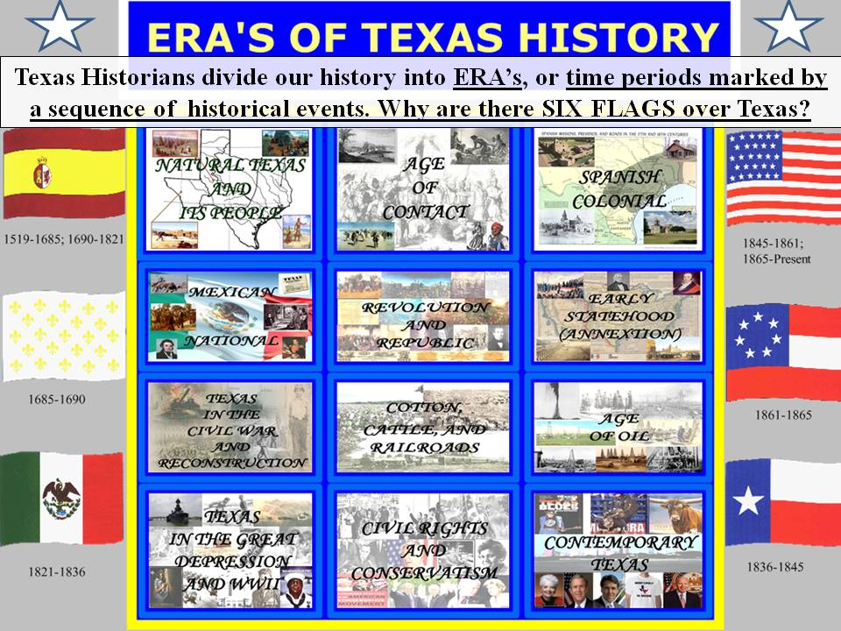
WHY HISTORIANS DIVIDE THE PAST INTO ERAS
History is divided into eras so it is easier to identify cause and effect of the great events/people in history

Slide 4
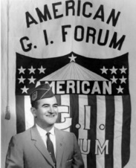
MAJOR ERAS IN TEXAS HISTORY
Civil Rights
  GI Forum
  Dr. Hector Garcia
  James Farmer
  Lyndon Johnson
  Henry B. Gonzalez
  Barbara Jordan
  Civil Rights Act of 1964
  Voting Rights Act of 1965
  NAACP in Texas
  LULAC

Slide 5
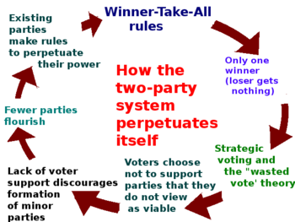
MAJOR ERAS IN TEXAS HISTORY
Conservatism
  State Government
  Republicans
  Phil Gramm
  Two-Party System
  George W. Bush
  Immigration
  Education

Slide 6
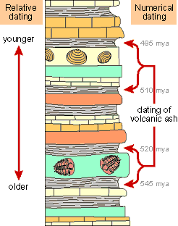
ABSOLUTE AND RELATIVE CHRONOLOGY THROUGH SEQUENCING
Relative Chronology
  A chronology that determines the age of a feature or event relative to the age of other features or events (for example, younger than or older than)
Absolute Chronology
  Absolute Chronology depends on knowing the precise date including the day, month and/or year of the event.

Slide 7
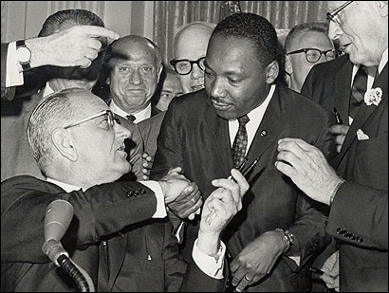
Civil Rights and Conservatism
Civil Rights and Conservatism – Examples of dates that can be used to identify absolute and relative chonology for this era include:
  1948 – GI Forum established
  1948 – Delgado vs. Bastrop
  1950 – Sweatt vs. Painter
  1952 – Tidelands Controversy
  1964 – Civil Rights Act
  1965 – Voting Rights Act
  1978 – Republican Bill Clements is elected governor, the first republican since Reconstruction
  1984 – U.S. Representative Phil Gramm switches parties
  1988 – Texan George H.W. Bush is elected President
  1994 – George W. Bush is elected Governor

Slide 8
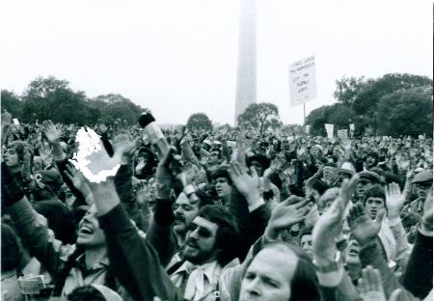
IMPACT OF PROGRESSIVE AND OTHER REFORM MOVEMENTS IN TEXAS IN THE 19th AND 20th CENTURIES
Evangelical Movement of the late 20th Century
  Late 1970s and 1980s saw the growth of active involvement of religious leaders in political affairs
  Republican Party supported by evangelical voters
  1990s – Republican Party had majority power in each branch of government and the State Board of Education

Slide 9
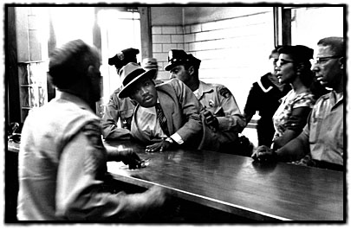
CIVIL RIGHTS AND EQUAL RIGHTS MOVEMENTS
Civil Rights Movements and Equal Rights Movements
  1942 – James Farmer founded the Congress of Racial Equality (CORE); organized non-violent protests such as freedom rides, sit-ins and boycotts
  1948 – The American G.I Forum was founded by Dr. Hector Garcia. Garcia and the G.I. Forum fought to help veterans specifically Mexican-Americans to obtain an education and health care.
  Oveta Culp Hobby served as the parliamentarian of the Texas Legislature and then became the Director of the Women’s Army Corp (WAC). She received the rank of colonel and received the Distinguished Service Medal (the first woman to receive this award).
  1940s – 1950s Lulu Bell Madison White was a civil rights activist devoted to the struggle against Jim Crow in Texas. She campaigned for the right to vote, for equal pay for equal work, and for desegregation of public facilities for African Americans. She was president of the Houston chapter of the NAACP.
  1964 – Civil Rights Act was signed by President Lyndon B. Johnson
  1965 – Voting Rights Act was signed by President Lyndon B. Johnson

Slide 10
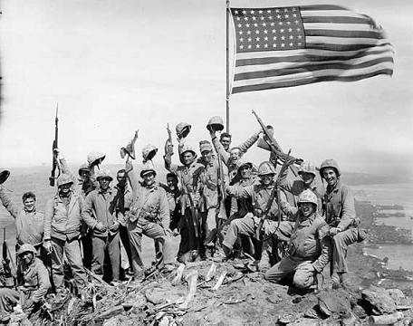
POLITICAL, ECONOMIC, AND SOCIAL IMPACT OF MAJOR EVENTS
Major Conflicts – Korea, Vietnam, and Gulf Wars
  Political impact
    Growth of military bases in Texas
  Economic impact
    Growth of oil industry used in conflicts
  Social impact
    Texas soldiers were involved and died due to conflicts
The Emergence of a two-party system
  Political impact
    Political action in the Texas Legislature slowed because both must compromise to pass legislation
  Economic Impact
    Economic issues are clearly defined by each party
  Social Impact
  Texans had a choice in elections

Slide 11
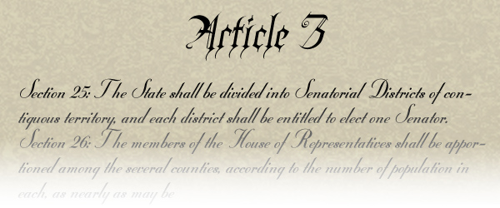
RIGHTS OF TEXAS CITIZENS
Rights of U.S. citizens
Rights defined in the Texas Constitution and Texas Bill of Rights
  Follows the U.S. Bill of Rights, but more specific
  Included in Articles of the Texas Constitution
  31 amendments in the Bill of Rights
  Freedom of speech and press
Some rights protected
  Republican form of government
  Equal rights and equality under the law
  Religion
  Protection of search and seizure
  Rights of the accused, and trial by jury
  Imprisonment for debt

Slide 12
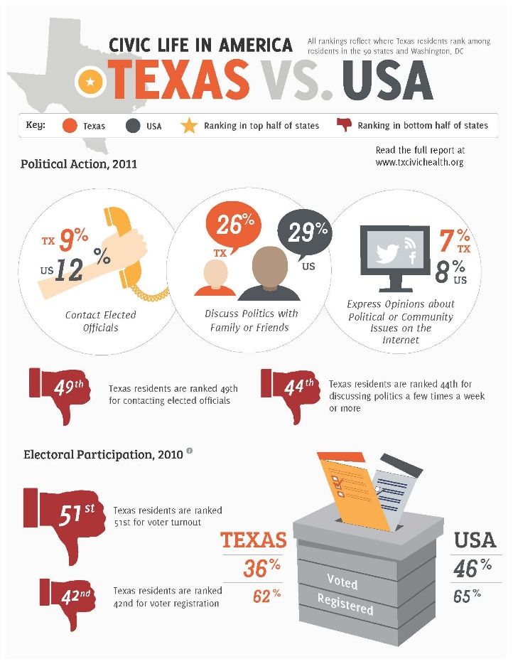
CIVIC RESPONSIBILITIES OF TEXAS CITIZENS
Civic responsibilities
  Vote (local, county, state and national elections)
  Lobby (a person or group of persons engaged in trying to influence legislators or other public officials in favor of a specific cause)
  Being informed by newspapers, television, and Internet
  Importance of civic participation

Slide 13

DIFFERENT POINTS OF VIEW ON IMPORTANT TEXAS ISSUES
Point of View – a way a person or group of people see things. A point of view is influenced by the historical context (values and beliefs of a time period) and frame of reference (personal background).
Political party
  Republicans – focus on big business and the economy of Texas; socially conservative
  Democrats – focus on improving social and environmental issues
  Interest groups – single item focus (e.g., oil and gas, anti-abortion, immigration)
  Texas issues – Past: _____________________
    Point of view of political party – Republican party
    Point of view of political party – Democratic party
    Point of view of interest group
  Texas issues – Present: ______________________
    Point of view of political party – Republican party
    Point of view of political party – Democratic party
    Point of view of interest group

Slide 14
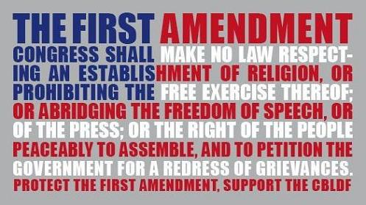
IMPORTANCE OF FREE SPEECH AND PRESS
Free speech and press is a basic human right. Freedom of speech to a certain degree defines the level of creativity and achievement in a society. Without freedom of speech, the people’s creativity and ability to solve problems are stifled. If the freedom to receive and give input is limited then it would be hard to discuss and know fully issues and options, limiting views and choices

Slide 15
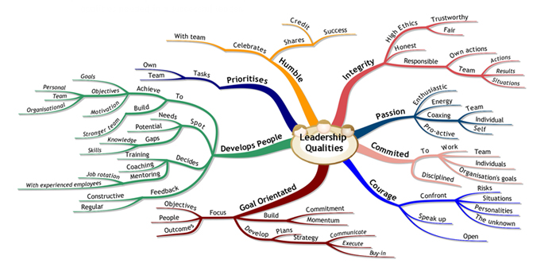
LEADERSHIP QUALITIES OF ELECTED AND APPOINTED LEADERS
Examples of leadership qualities to be applied
  Intelligent
  Wise
  Courageous
  Brave
  Aware of different cultures of the world
  Decision-maker
Texans who have been president of the United States
  Dwight Eisenhower – born in Texas, but considered Kansas his home
  Lyndon B. Johnson
  George H.W. Bush
  George W. Bush
  Other elected and appointed leaders

Slide 16
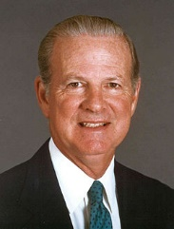
CONTRIBUTIONS OF TEXAS LEADERS
James A. Baker III
  Served as the Chief of Staff in President Ronald Reagan's first administration and in the final year of the administration of President George H. W. Bush
  Served as Secretary of the Treasury from 1985-1988 in the second Reagan administration
  Served as Secretary of State in the George H. W. Bush administration
Henry B. González
  Served as US Congressman who fought for equality in health care, housing, and justice for all.
Kay Bailey Hutchison
  Served as the first female US Senator from Texas
  Brought federally funded projects to Texas

Slide 17
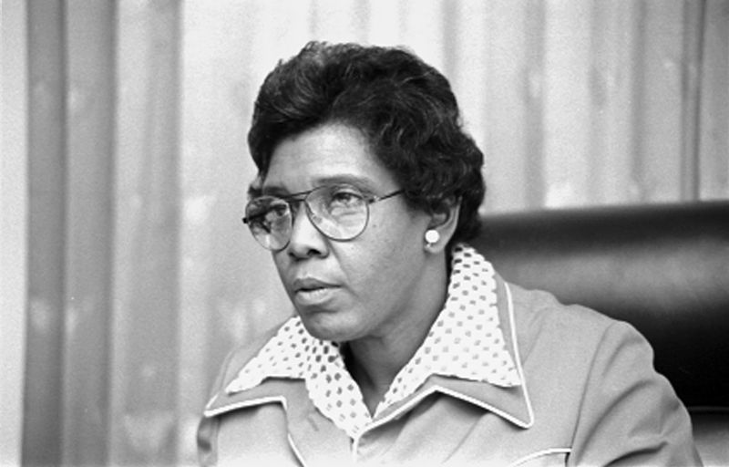
CONTRIBUTIONS OF TEXAS LEADERS
Barbara Jordan
  Served as the first African American to serve in the state senate in a century and first African American woman from the South ever to serve in the US Congress
Raymond L. Telles
  Telles was elected El Paso’s first Mexican-American mayor in 1957 and served as the first Mexican American of a major American city.
  Served as Ambassador to Costa Rica under John F. Kennedy
  Served as chairman of the U.S.-Mexican Border Commission in 1967
  Served as chairman of the Equal Employment Opportunity Commission for the United States in 1971
Raul A. Gonzalez Jr.
  Was a Houston city attorney
  Served as the Assistant U.S. attorney for the Southern District of Texas in Brownsville
  Served as the District Judge of the 103rd Judicial District
  Served as the Associate justice on the Thirteenth Court of Appeals
  Associate justice of the Texas Supreme Court

