Slide 1
Unit 4
Spanish Colonial

Slide 2
WHY HISTORIANS DIVIDE THE PAST INTO ERAS
History is divided into eras so it is easier to identify cause and effect of the great events/people in history

Slide 3
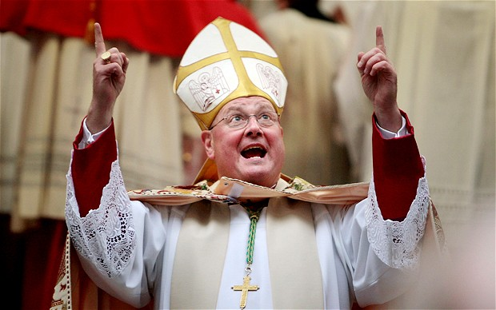
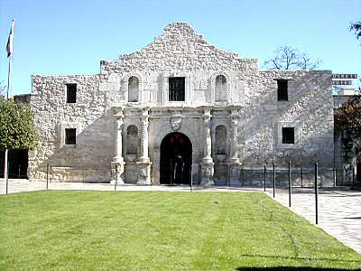
DEFINING CHARACTERISTICS OF MAJOR ERAS IN TEXAS HISTORY- Spanish Colonial
Roman Catholic religion
Missions and Presidios
Civil Settlements
Canary Islanders
Founding of San Antonio
Camino Reale

Slide 4
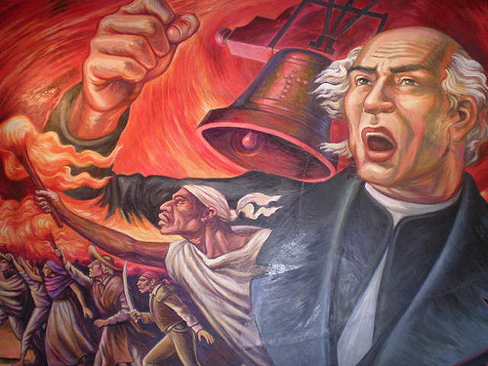
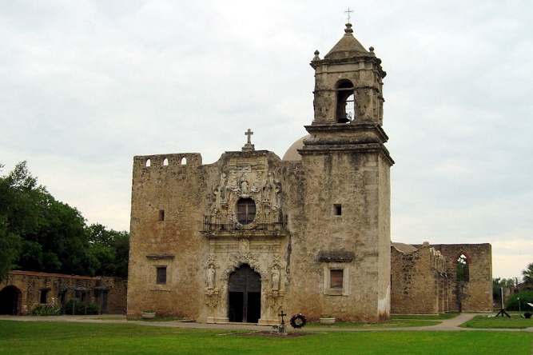
ABSOLUTE AND RELATIVE CHRONOLOGY THROUGH SEQUENCING SIGNIFICANT INDIVIDUALS, EVENTS, AND TIME PERIODS-Spanish Colonial
1682 – Spaniards establish the first Texas mission at Corpus Christi de la Ysleta
1731 – East Texas missions are moved to San Antonio
1718 – Founding of San Antonio
1782 – Mission San Jose is completed in San Antonio and other missions are built
1810 – Father Hidalgo’s speech encourages Mexicans, Texans, and others to fight for independence

Slide 5
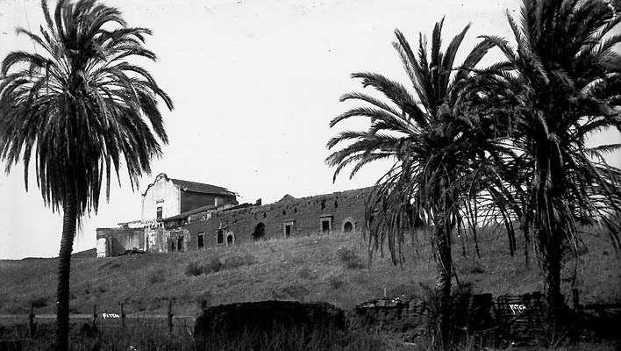
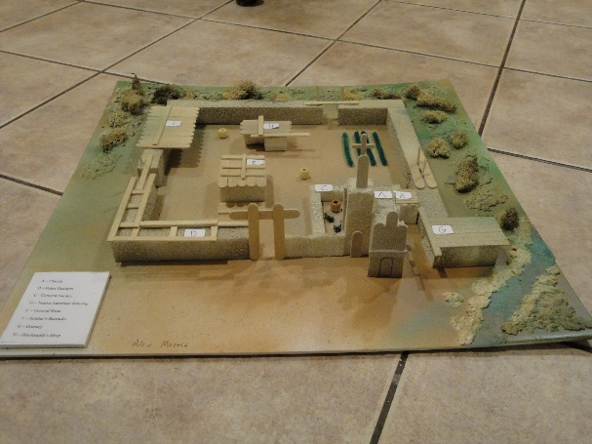
IMPORTANT EVENTS AND ISSUES RELATED TO EUROPEAN COLONIZATION OF TEXAS- Spanish Colonial
The establishment of Catholic missions, towns, and ranches, and individuals
Missions were Spain’s main way of colonizing and were expected to be self-supporting. The first missions were established in the El Paso area, then East Texas and finally in the San Antonio area. Missions were used to convert the American Indians to the Catholic faith and make loyal subjects to Spain. Native Americans viewed the construction of new Spanish missions with suspicion.
Towns – towns and settlements were built near the missions and colonists were brought in for colonies to grow and survive. The first group of colonists to establish a community was the Canary Islanders in San Antonio (1730).
Ranches – ranching was more conducive to where missions and settlements were thriving (San Antonio). Cattle were easier to raise and protect as compared to farming.

Slide 6
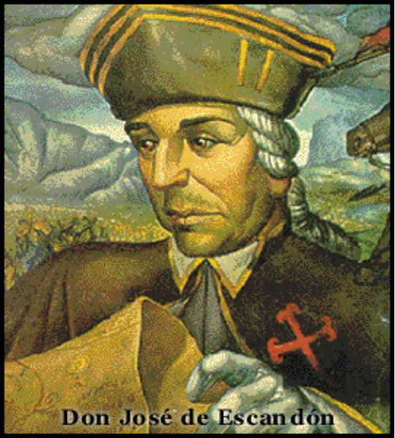
IMPORTANT EVENTS AND ISSUES RELATED TO EUROPEAN COLONIZATION OF TEXAS- Spanish Colonial
Fray Damián Massanet
Convinced the viceroy of New Spain to colonize East Texas and convert the Caddoes to Catholicism
1690 – Alonso De León and Massanet were sent with several priests and about 100 soldiers to colonize East Texas.
Resulted in many missions in East Texas even though these missions failed
José de Escandón (1750s)
Military commander and governor of Nuevo Santander
Led Spain’s expansion effort in South Texas
Sent settlers, soldiers and priests to settle the lands between the Rio Grande and Nueces River establishing missions, presidios, and settlements
Moved La Bahia mission and presidio from the Guadalupe River to the present-day site of Goliad

Slide 7
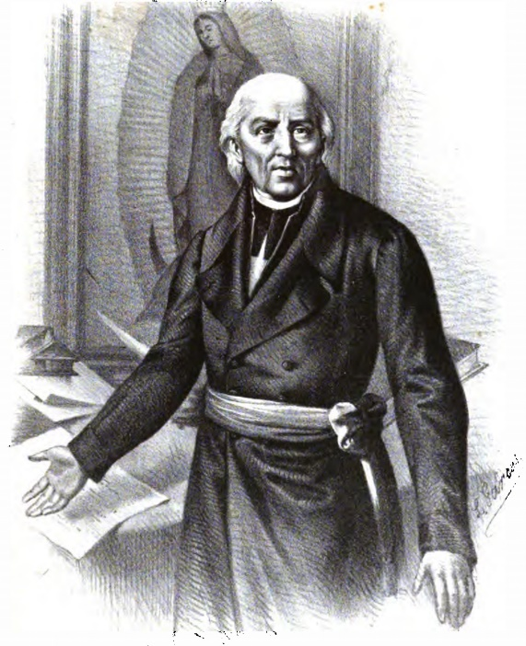
IMPORTANT EVENTS AND ISSUES RELATED TO EUROPEAN COLONIZATION OF TEXAS- Spanish Colonial
Antonio Margil de Jesús (early 1700s)
Spanish Franciscan priest
Founded several missions in East Texas including Nuestra Señora de los Dolores and San Miguel de los Adaes
Due to the problems in East Texas, he moved to San Antonio and founded San Jose y San Miguel de Aguayo, one of the five missions in San Antonio today.
Francisco Hidalgo (early 1700s)
Priest at Mission San Francisco de los Tejas
Contacted French Catholic priests to provide religious services to the local native people when Spanish priests were not available
Caused Spanish to be suspicious of French colonization

Slide 8
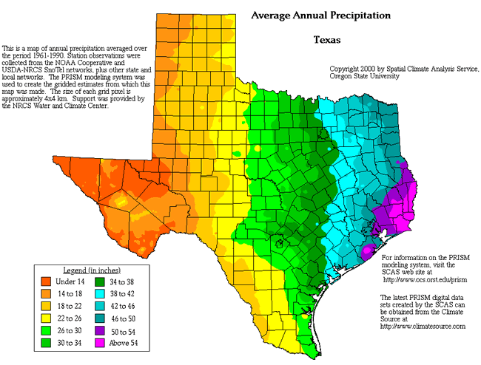
Spanish Colonial
How did geography affect where missions were built in Texas?
Why did central Texas become the area the Spanish decided to build the majority of their missions?
The first Spanish settlers who came to Texas based the design of their homes and missions primarily around what was available for building materials and how much manpower was a vailable for building. This meant that many missions were built from logs and stones that were easy to find. Missions were built usually near fresh water as well as on good farm land. A location on high ground would protect from floods.

Slide 9
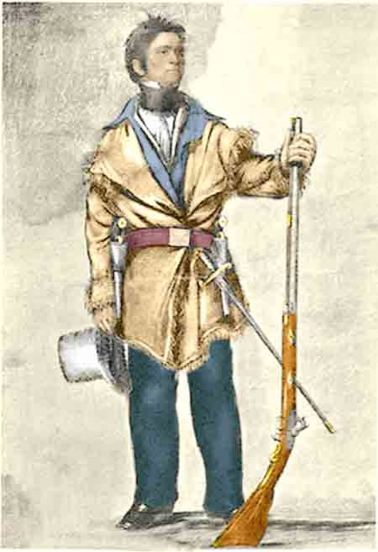
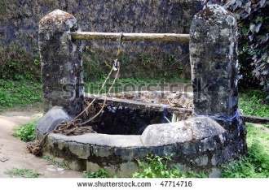
WAYS TEXANS HAVE ADAPTED TO AND MODIFIED THE ENVIRONMENT- Spanish Colonial
Colonial homes – built from timber and rocks
Dog Run homes – built with a breezeway for shade and to catch the breeze
Home furnishing – made from natural resources in the area
Buckskin clothes – made from deer hide
Water wells – built to acquire water near their home
Food – killed animals and grew crops

Slide 10
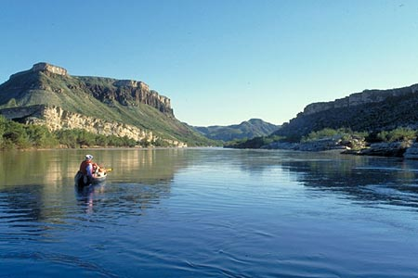
EXAMPLES OF SPANISH INFLUENCE AND THE INFLUENCE OF OTHER CULTURES ON TEXAS
Place names
Amarillo – in Spanish it means yellow. This was the color of the soil of the area and the beautiful wildflowers. Named by early settlers in this area
Rio Grande – in Spanish it means “Big River”
Most Texas rivers and landforms
Vocabulary
Vaquero – Spanish word for cowboy
Rodeo – a sport that is based on the skills of cowboys or vaqueros
Religion
Roman Catholic

Slide 11
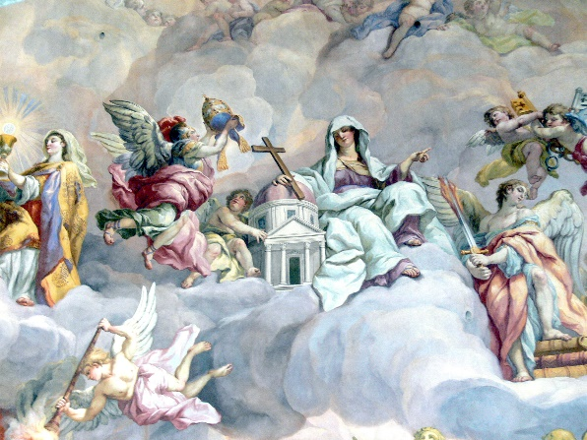
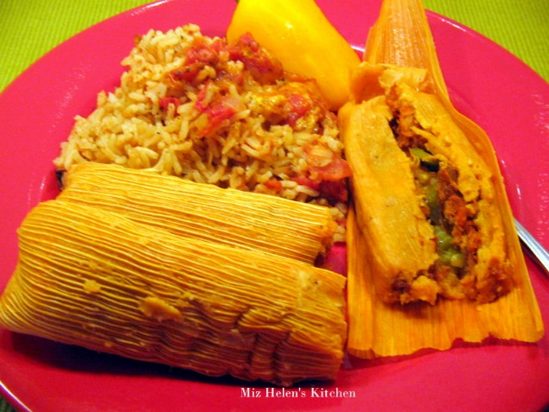
EXAMPLES OF SPANISH INFLUENCE AND THE INFLUENCE OF OTHER CULTURES ON TEXAS
Architecture
Home – hacienda
Presidio – fort
Aceqias – wells (aquifer)
Adobe – brick
Arch – style of architecture
Food
Tortillas – flat bread made of corn
Tamales – dumpling made of corn flour and meat
Arts
Corridos – ballads
Frescos – mural painting found in Catholic churches
Tejano Music – music that originated from the cultural convergence of Spanish, German, Czech, and Polish music and instruments

