Slide 1
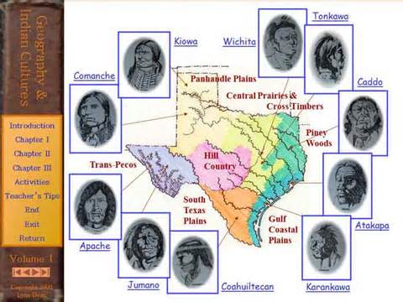
Unit One
Era: Natural Texas and its People
Cultures of American Indians in Texas

Slide 2
WHY HISTORIANS DIVIDE THE PAST INTO ERAS
History is divided into eras so it is easier to identify cause and effect of the great events/people in history

Slide 3
Important Vocabulary Terms
Adobe – mud mixed with a small amount of straw or grass and dried in the Sun
Agriculture – the raising of plants and animals for food
Nomad – a person who moves from place to place and has no permanent home
Region – an area that is used to identify and organize areas of the Earth’s surface for various purposes
American Indians- Adapted and used the environment to meet needs

Slide 4
American Indians in Texas
Gulf Coast – nomadic and hunters/gatherers
Karankawa – Southeast, used dugout canoes to fish and hunt small animals. Cabeza de Vaca wrote about Karankawas. (Nomads)
Coalhuiltecans – South Texas, ate bugs and small animals. (Nomads)
Atakapans – hunted small animals and fished in dugout canoes, some farming
Caddoes – built dome shaped huts, organized government system led by a chief, women played important roles, greeted European with the word Tejas, which means friends- Lived in North-East Texas but in the Coastal Plains
Great Plains – nomadic, dependent on the buffalo, and were fierce warriors
Comanche – used every part of the buffalo, lived in tipis, domesticated animals before they were introduced to the horse by the Europeans- Lived in the Great Plains
Apache – used buffalo hide to protect themselves from the harsh landscape. For part of the year lived in farming communities along rivers and streams called rancherias. (Nomads)
Kiowas – recorded oral histories on their tipis, made beautiful crafts, developed a calendar, and were the most-feared group on the plains- (Nomads) Depended on the Buffalo

Slide 5
American Indians in Texas
Mountain and Basin- (Puebloan) – sedentary, farmers, and lived in houses made of adobe
Jumanos – besides farming, hunted, traded, and lived in beautiful painted adobe homes- Lived in the Mountain and Basin Region
Tiguas – known for their beautiful pottery
North Central Plains – sedentary food-rich environment and complex social systems
Wichitas – hunted buffalos, grew crops, and known for the tattoos around their eyes known as “raccoon eyes”

Slide 6
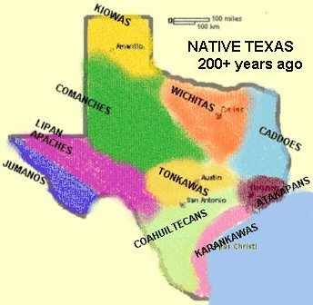
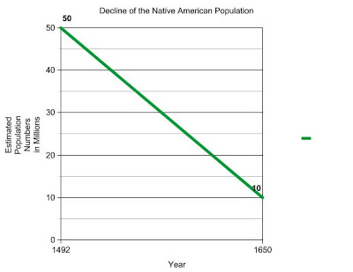
American Indians in Texas
Natural Texas and its people
Maps
Regions of Texas
Regions that American Indians inhabited in Texas
Graph (bar, line, or circle)
Population of American Indians in Texas prior to the arrival of Europeans
Artifacts- Used to determining the lifestyle of American Indians in early Texas

Slide 7
REGIONS AND PLACES OF IMPORTANCE IN TEXAS DURING THE 19th, 20th, AND 21st CENTURIES
Regions
Mountains and Basins
Great Plains
North Central Plains
Coastal Plains

Slide 8
REGIONS AND PLACES OF IMPORTANCE IN TEXAS DURING THE 19th, 20th, AND 21st CENTURIES
Cities
20th century and 21st century
Austin
San Antonio
Houston
Ft. Worth
Dallas
El Paso
Brownsville
Lubbock
Amarillo
Midland
Odessa

Slide 9
REGIONS AND PLACES OF IMPORTANCE IN TEXAS DURING THE 19th, 20th, AND 21st CENTURIES
Rivers
Sabine
Red
Rio Grande
Nueces
Neches
Trinity
Brazos
Colorado
Guadalupe
San Antonio
Pecos

Slide 10
REGIONS AND PLACES OF IMPORTANCE IN TEXAS DURING THE 19th, 20th, AND 21st CENTURIES
Natural and historic landmarks
Llano Estacado (natural)
Balcones Escarpment (natural)
Palo Duro Canyon (natural)
Located in the Great Plains

Slide 11
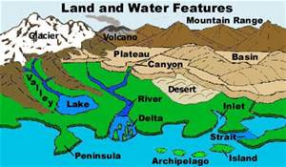
PLACES AND REGIONS OF TEXAS IN TERMS OF PHYSICAL AND HUMAN CHARACTERISTICS
Region – a spatial area of the Earth’s surface that is defined by common properties
Physical and human characteristics – physical characteristics of places include landforms and soils, bodies and sources of water, vegetation, climate, weather patterns, and animal life. One physical characteristic of Texas is that the elevation slowly rises from east to west.
Human characteristics of places include the language, religion, political systems, economic systems, population distribution, ethnicity, age, and standards of living.

Slide 12
PLACES AND REGIONS OF TEXAS IN TERMS OF PHYSICAL AND HUMAN CHARACTERISTICS
Coastal Plains
Physical characteristics
Plains, desert, hills, Balcones Escarpment
All rivers flow through this region
Wrong way rivers that take water from driest part of state to the wettest part of the state
Climate – mild
Low Elevation
Human Characteristics
Highway systems
Location of most major cities- most are built where American Indians settlements were, by waterways and transportation routes
Industries – timber, agriculture, oil and gas, technology, industry, education
Dams, Fishing, tourism, intra-coastal waterway

Slide 13
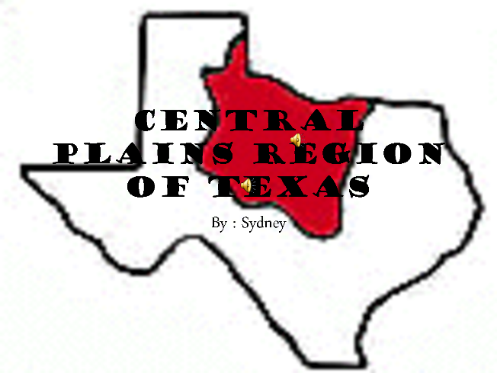
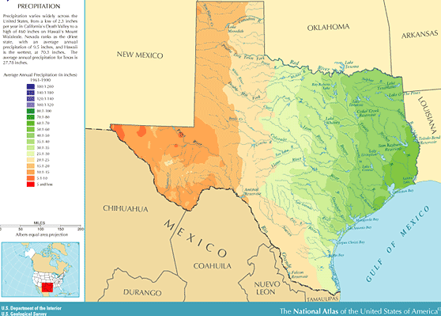
PLACES AND REGIONS OF TEXAS IN TERMS OF PHYSICAL AND HUMAN CHARACTERISTICS
North Central Plains
Physical characteristics
Rolling prairies/plains, a few rivers
Climate – hot short summer, cool to cold winters
Human characteristics
Industries – agriculture, manufacturing, military defense

Slide 14
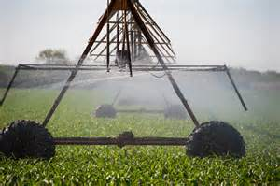
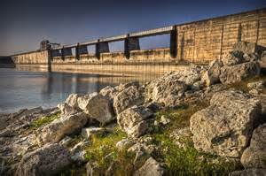
PLACES AND REGIONS OF TEXAS IN TERMS OF PHYSICAL AND HUMAN CHARACTERISTICS
Great Plains
Physical characteristics
Canyons, escarpments, plains, aquifers, plateaus
Climate – hot summers, cold winters
Human characteristics
Irrigation
Industries – ranching and agriculture
Wind farms
Dams – Amistad
Oil/gas and ranching

Slide 15
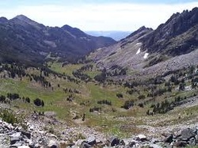
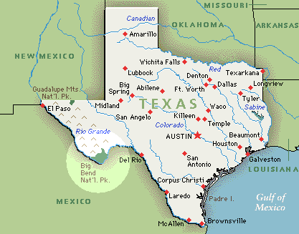
PLACES AND REGIONS OF TEXAS IN TERMS OF PHYSICAL AND HUMAN CHARACTERISTICS
Mountains and Basins
Physical characteristics
River, deserts
Climate – hot days, cold nights, hot short summers, cold winters
High Elevation
Human characteristics
Industries – cattle, sheep and goat ranching
Big Bend National Park
Dams

