Slide 1
Unit Two
Age of Exploration
1500-1600

Slide 2
WHY HISTORIANS DIVIDE THE PAST INTO ERAS
History is divided into eras so it is easier to identify cause and effect of the great events/people in history

Slide 3
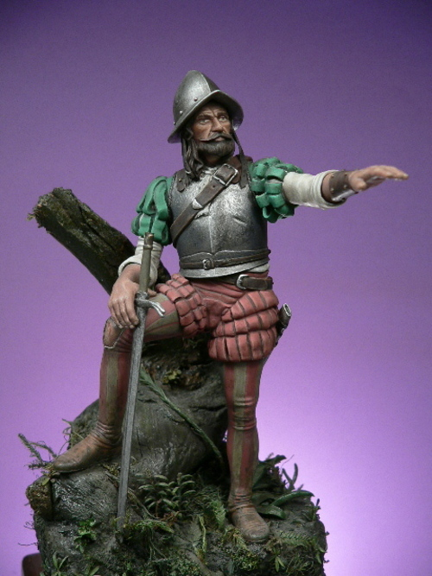
Important Vocabulary
Absolute Chronology - the arrangement of dates, events, etc., in order of occurrence (your birth date)
Relative Chronology - A chronology that determines the age of a feature or event relative to the age of other features or events (for example, younger than or older than)
Conquistador – a Spanish explorer who searched for wealth and land in the Americas
Expedition – a journey undertaken by a group of people with a definite purpose
Exploration – travel undertaken to discover what a place is like or where it is

Slide 4
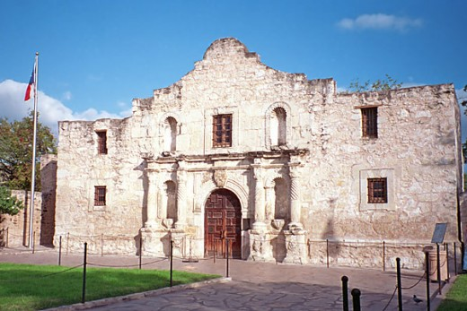
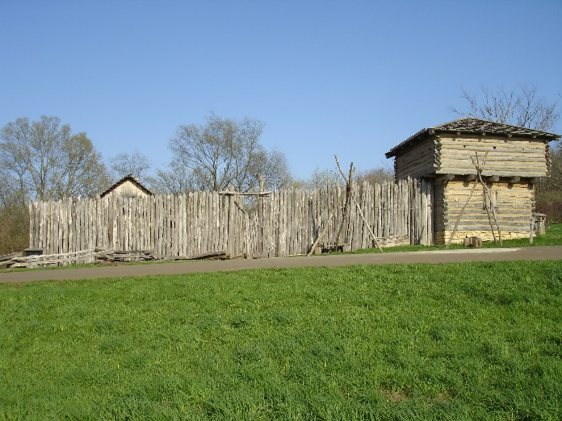
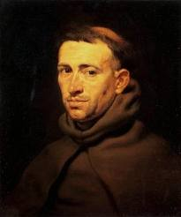
Important Vocabulary
Friar – are called to live the evangelical counsels (vows of poverty, chastity and obedience) in service to society
Mission – a series of religious outposts established by Spanish Catholic Dominicans, Jesuits, and Franciscans to spread the Christian doctrine among the local Native Americans
Viceroy – is a regal official who runs a country, colony, or city province (or state) in the name of and as representative of the monarch.
Pueblo – Spanish explorers of the Southwest used this term to describe the communities housed in apartment-like structures built of stone, adobe mud, and other local material.
Stockade – is an enclosure of palisades and tall walls made of logs placed side by side vertically with the tops sharpened to provide security
Sandbar – a ridge of sand built up by currents in a river or coastal waters

Slide 5
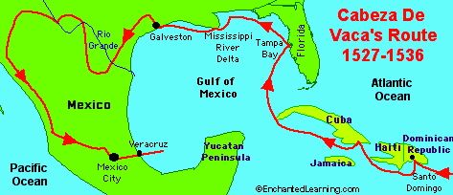
DEFINING CHARACTERISTICS OF MAJOR ERAS IN TEXAS HISTORY
Age of Contact
Spanish exploration
French exploration
Cabeza De Vaca
LaSalle
Fort St. Louis
Pineda mapping Texas
Spanish conquistador

Slide 6
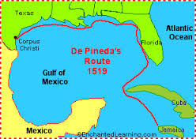
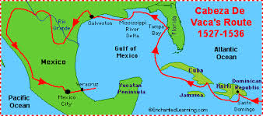
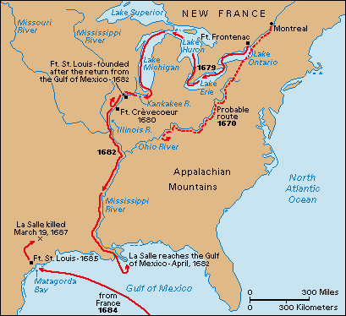
Age of Exploration
Age of Contact – Examples of dates that can be used to identify absolute and relative chronology for this era include:
1519 – Pineda maps Texas
1537 – Cabeza de Vaca reports on Texas
1685 – LaSalle establishes Fort St. Louis

Slide 7
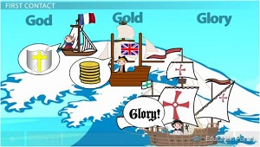
IMPORTANT INDIVIDUALS, EVENTS, AND ISSUES RELATED TO EUROPEAN EXPLORATION OF TEXAS
Alonso Álvarez de Pineda was the first explorer to map the coast of Texas.
Álvar Núñez Cabeza de Vaca and his writings – shipwrecked and captured by American Indians, he ended up traveling across Texas, and was the first person to write about, and report about Texas.
The search for gold
Gold – the Spanish heard that there was gold in Texas. The Spanish wanted to increase their global wealth. Helped to get sailors to explore America
Glory – expeditions were led by conquistadors looking for wealth and fame for themselves.
God – the Catholic Church agreed to help support the expeditions to convert American Indians in Texas to Christianity and increase the wealth of the Church.

Slide 8
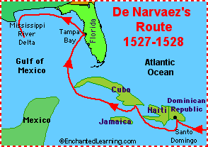
IMPORTANT INDIVIDUALS, EVENTS, AND ISSUES RELATED TO EUROPEAN EXPLORATION OF TEXAS
The Narváez expedition was a Spanish attempt during the years 1527–1528 to colonize Spanish Florida. It was led by Pánfilo de Narváez, who was appointed to rule as adelantado.
The crew initially numbered about 600, including men from Spain, Portugal and Italy. Making stops along the way to Florida at Hispaniola and Cuba, the expedition suffered a hurricane, among other storms. After landing near Tampa Bay, they were subject to attacks by American Indians, and suffered the effects of poor food and disease. By September 1528, following an attempt to sail from Florida to Mexico, only 80 men survived after being swept onto Galveston Island, Texas. Over the next few years, more men died, and only four of the original party survived.

Slide 9
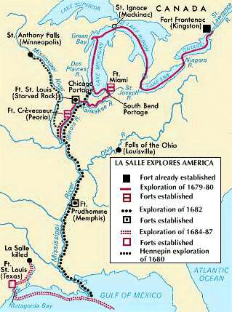
IMPORTANT INDIVIDUALS, EVENTS, AND ISSUES RELATED TO EUROPEAN EXPLORATION OF TEXAS
Conflicts reinforced Spanish claims to Texas, which led to an increase number of missions and presidios being constructed in Texas
Rene-Robert Cavelier, Sieur de LaSalle was given ships, colonists, and soldiers by the French King to start a new colony at the mouth of the Mississippi. He landed/shipwrecked at Matagorda Bay instead. He tried to establish a colony, but failed because of attacks by American Indians and disease. LaSalle left the colony to find a way home and was believed to be shot by his own men. The survivors were found by Spanish soldiers. Spain feared that France would try to claim Texas and renewed their colonization efforts in Texas.

Slide 10
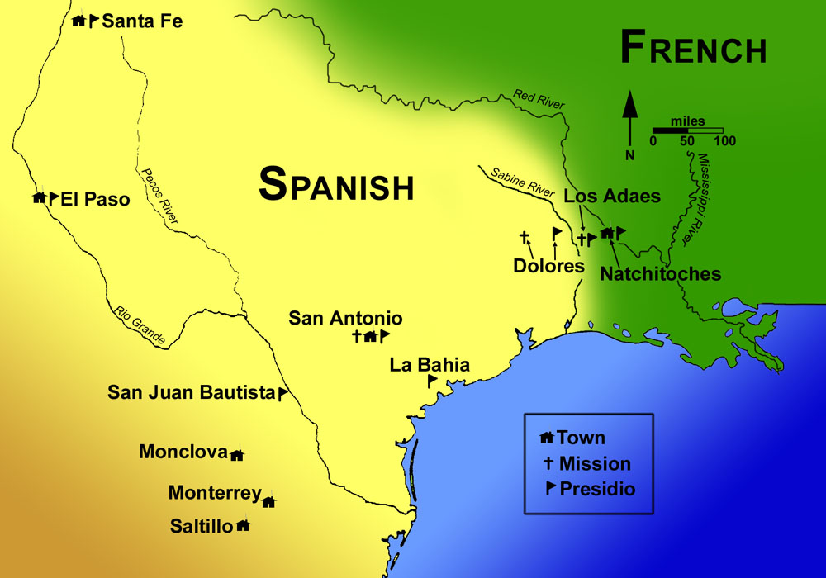
IMPORTANT INDIVIDUALS, EVENTS, AND ISSUES RELATED TO EUROPEAN EXPLORATION OF TEXAS
The “Chicken War” – French soldiers were sent to capture a Spanish mission in East Texas because of a conflict between France and Spain in Europe. The French soldiers looted the mission and captured a Spanish soldier. The French leader was thrown from his horse because of the chickens in the courtyard. The Spanish soldier was able to escape. The story was exaggerated and embarrassing to the Spanish viceroy. The Spanish became more determined to hold Texas.

